Slide 1
QUICKFEED A NEWS WEBSITE
TEAM MEMBERS
1. SYED KHASIM(20CS1112)
2. SALAGRAMA SRI VENKATESWARLU(20CS1098)
3. SUVALAKSHMI R(20CS1111)
4. REVU KAVITHA(20CS1094)

Slide 2
PROBLEM STATEMENT
Our Quick Feed website is focusing on providing relevant and engaging content to our diverse audience while maintaining their trust and loyalty
We ensure that our website delivers content that is interesting, accurate, and reliable, without being biased or repetitive

Slide 3
OBJECTIVE
To provide the audience with timely and reliable information on a range of topics, including local and international news, politics, sports, entertainment and more
To serve as a platform for discussion and create awareness about important issues and topics

Slide 4
ABOUT OUR WEBSITE
We retain our audience and encourage them to visit our website regularly by providing them with badges on their contribution for writing an article on the blog posted, in the midst of fierce competition from other news providers.
We display the top 100 articles based on the likes user given
Save news to read it later according to our time convenience

Slide 5
MODULES
USER REGISTERATION
USER LOGIN
NEWS FROM VARIOUS RANGE OF TOPICS (like Sports, Entertainment and more….)
SUBSCRIPTION (Monthly, Yearly)
ARTICLES
BLOGS
TOP 100 ARTICLES
CONTACT US (For any reporting issues)

Slide 6
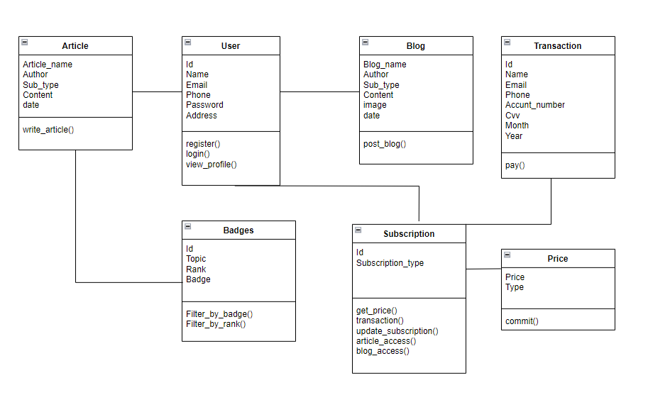
CLASS DIAGRAM

Slide 7
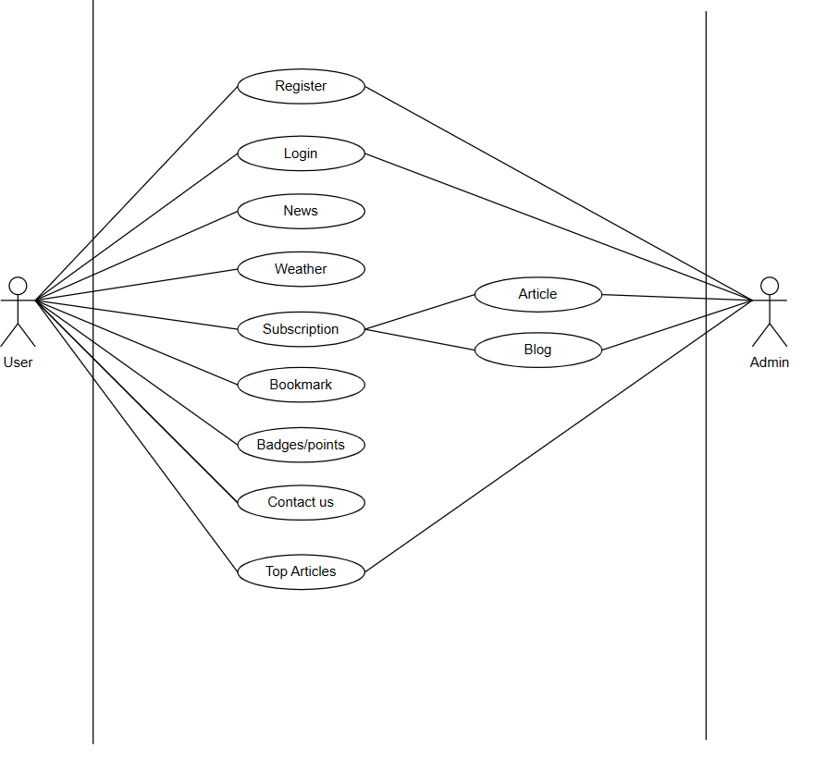
USE CASE DIAGRAM

Slide 8
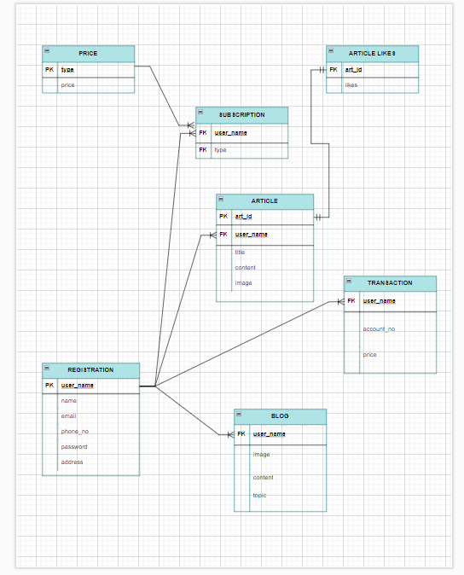
ER DIAGRAM

Slide 9
Junit & Mockito
Used Mockito & Junit framework for testing the functionalities.
Objectives:
unit tests that cover different scenarios
To isolate the code being tested
To control the behavior of dependencies
Methods:
MVCAppTest.java
RequestTest.java
SpringBootProjectApplicationTest.java

Slide 10
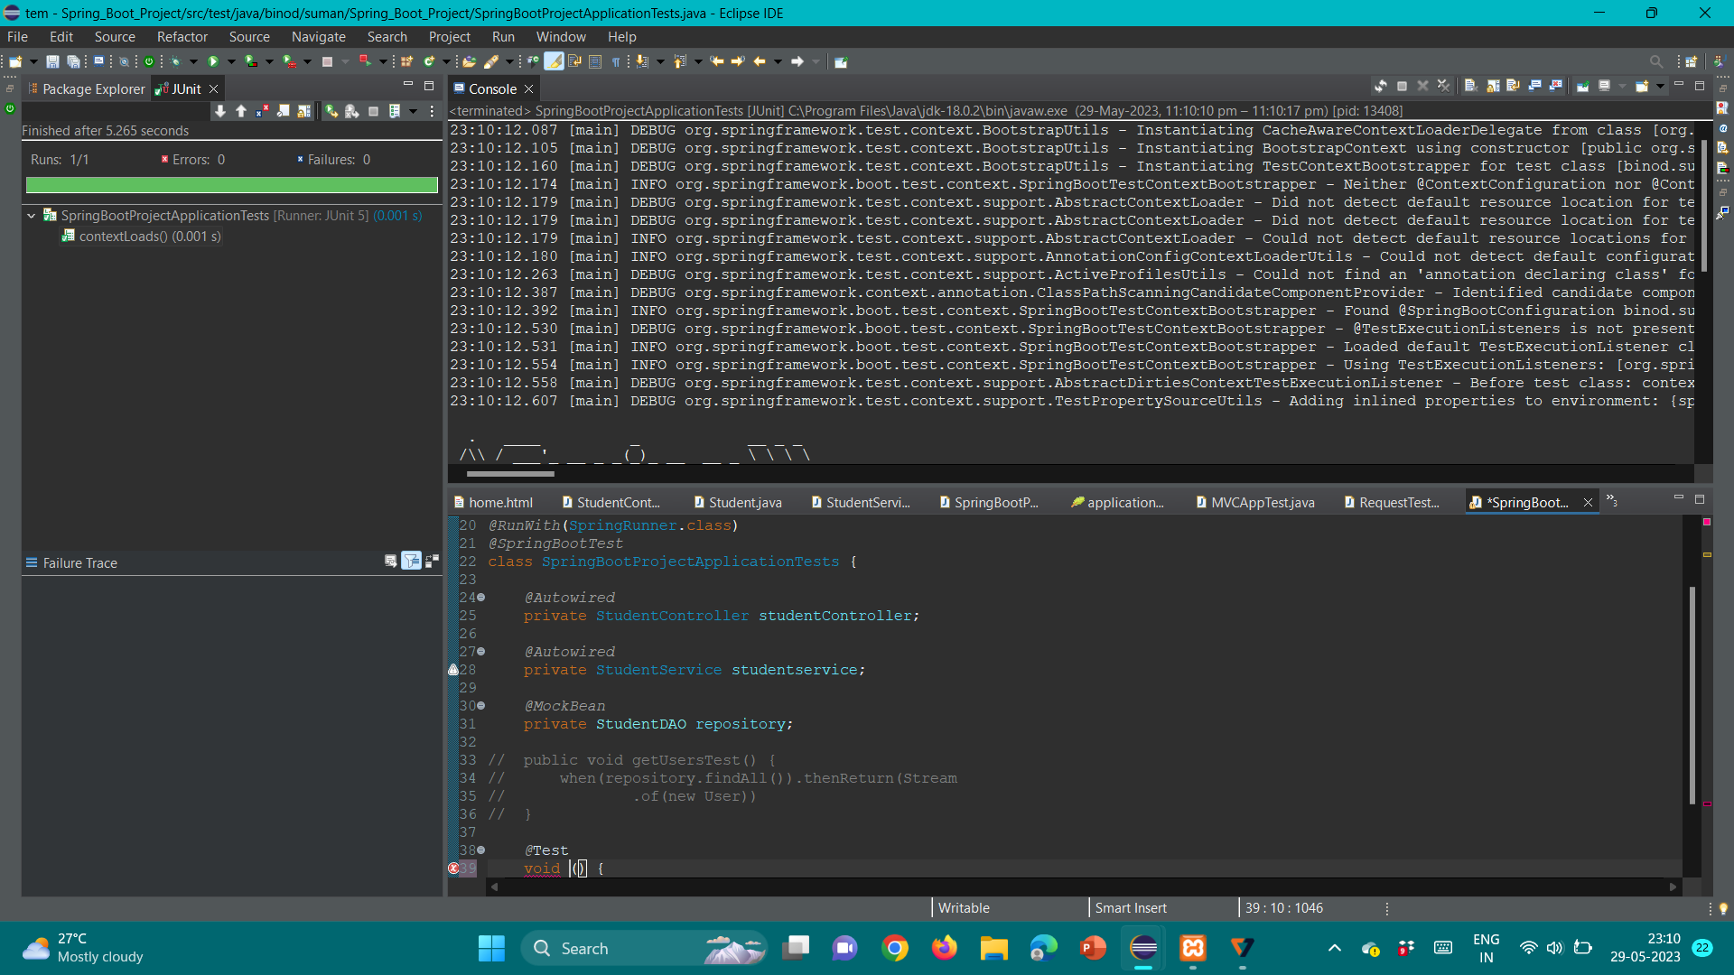
SpringBootProjectApplicationTest.

Slide 11
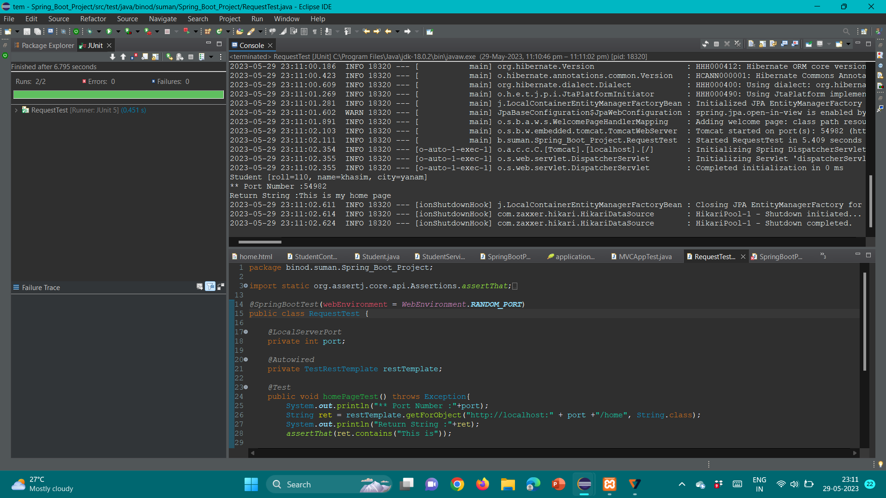
RequestTest.java

Slide 12
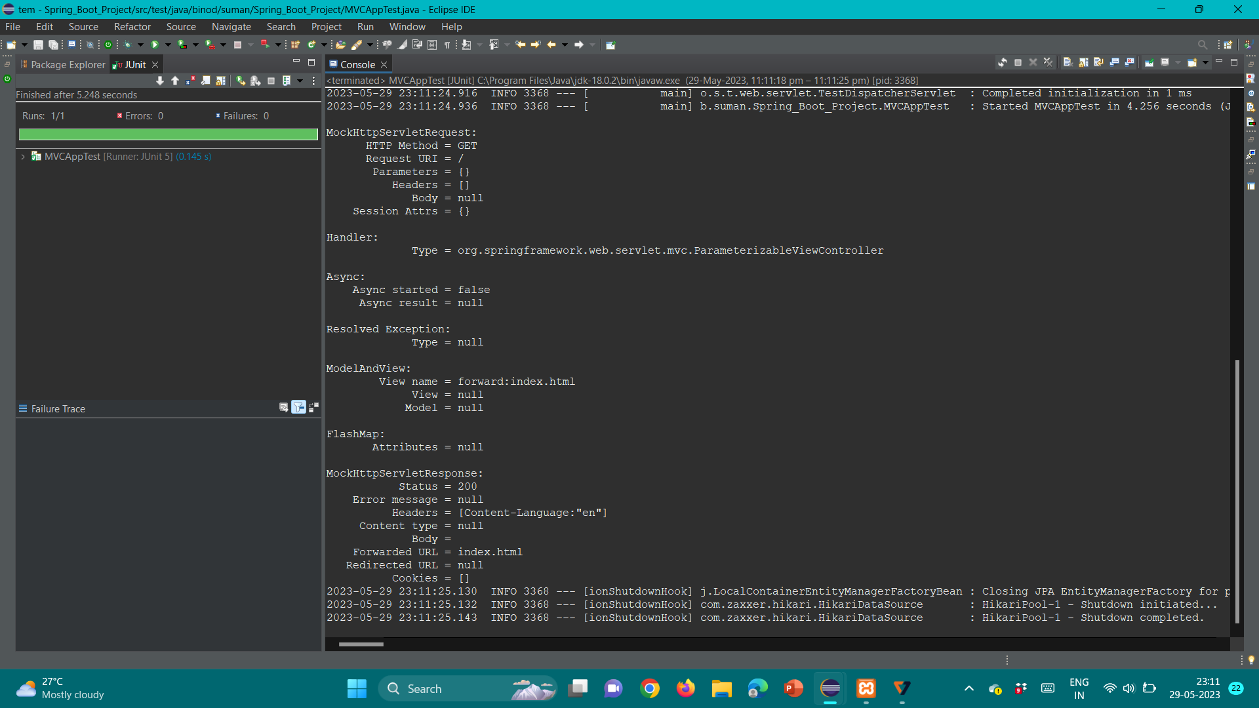
MVCAppTest.java

Slide 13
CODE COVERAGE
Modules considered:
Login / Reg
Mscommunication
Article
Blog

Slide 14
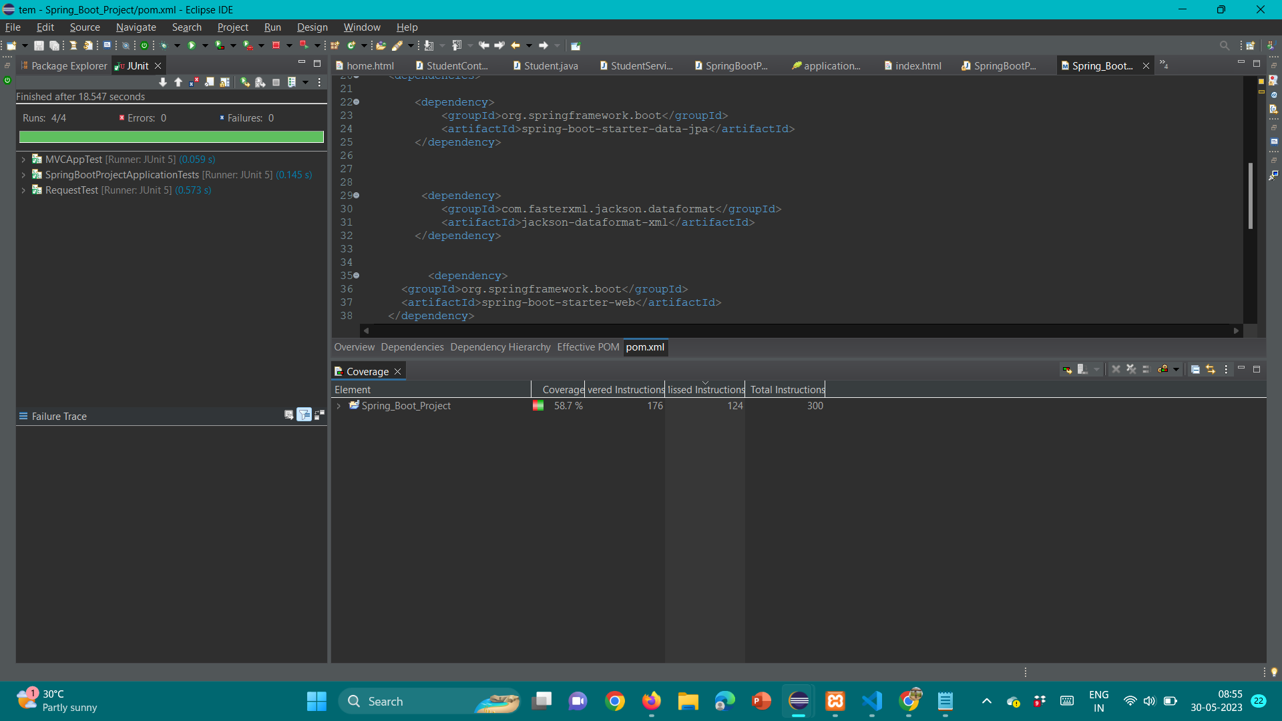
Login/reg

Slide 15
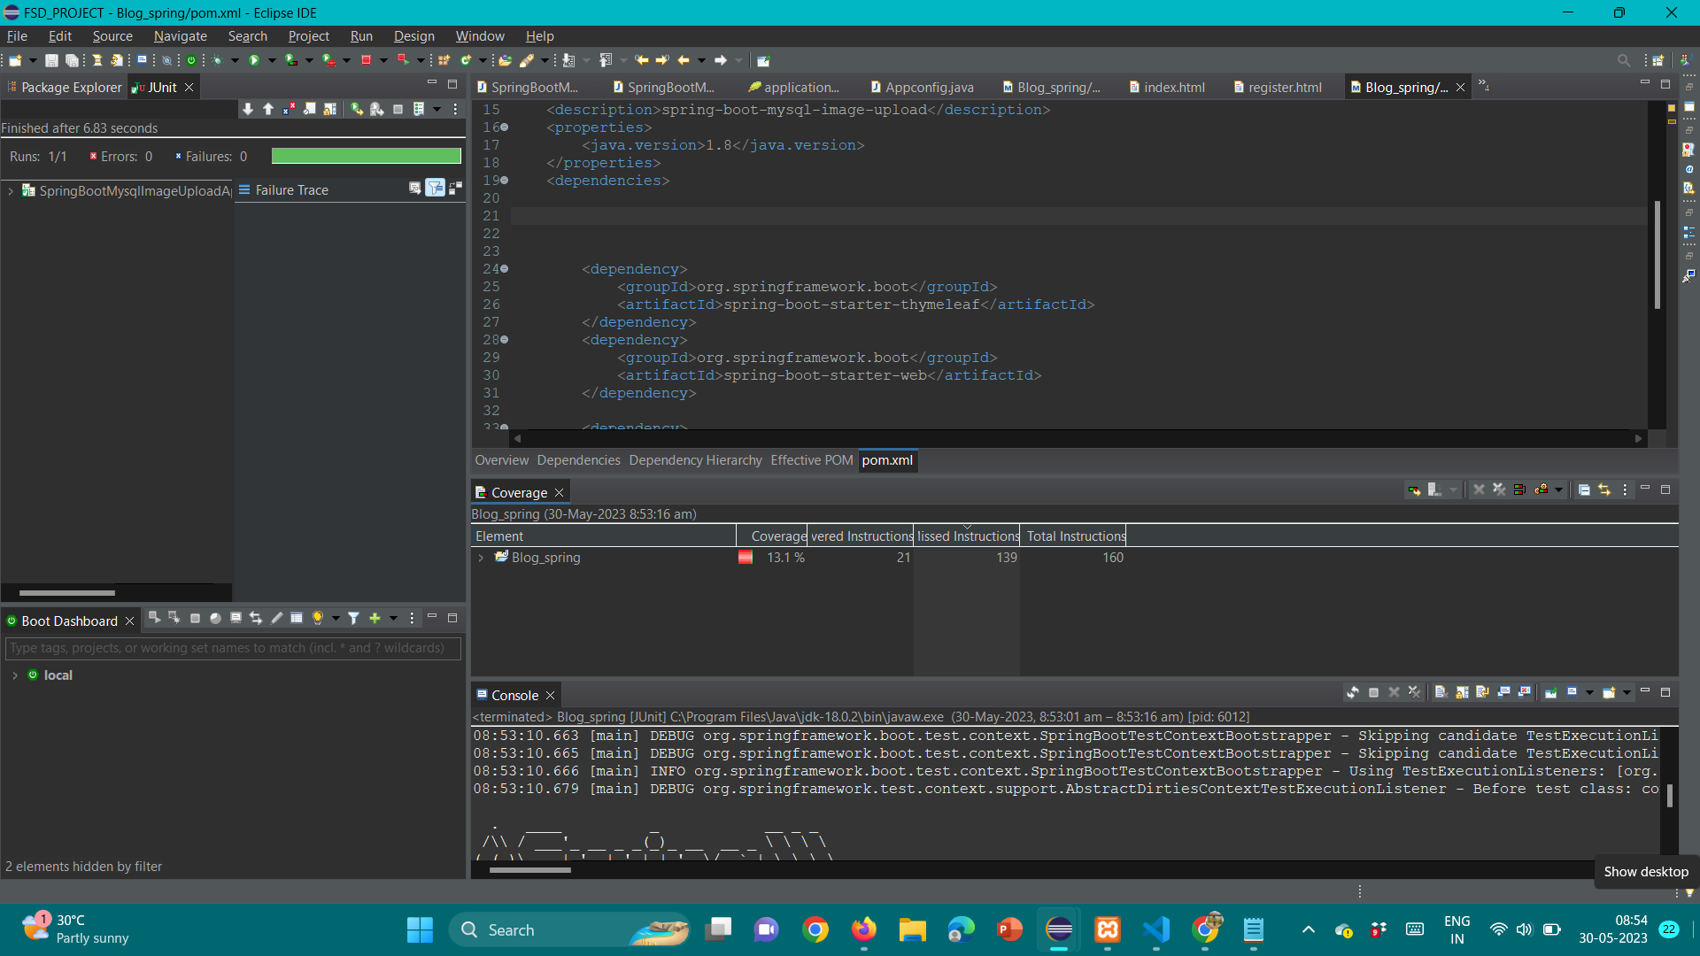
Mscommunication

Slide 16
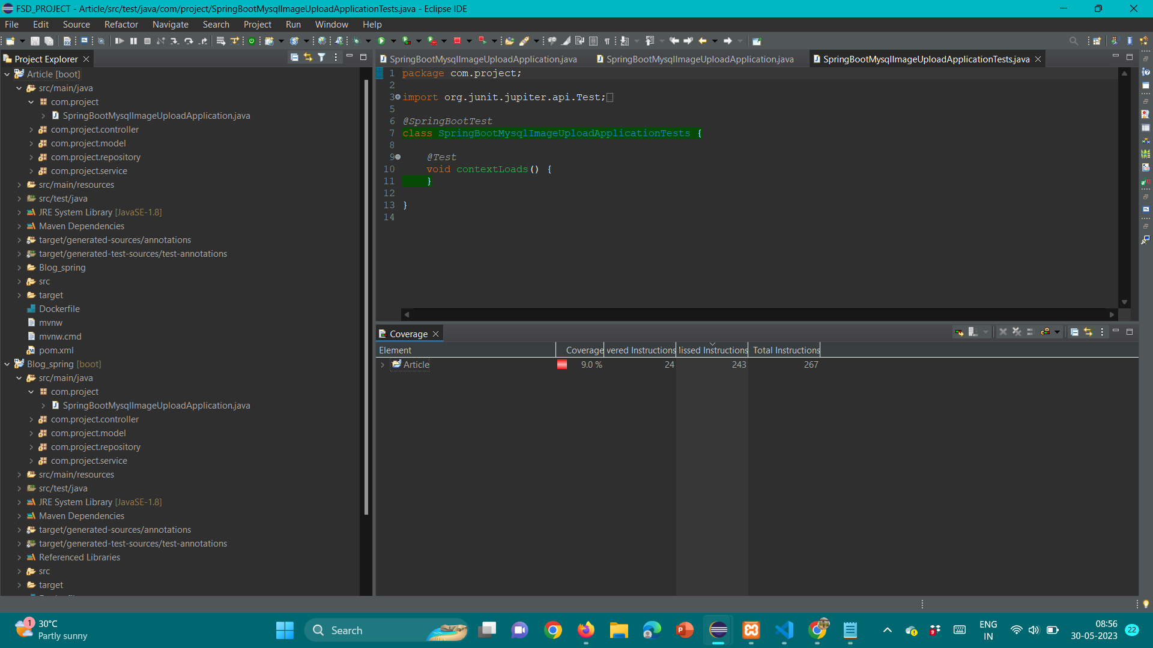
Article

Slide 17
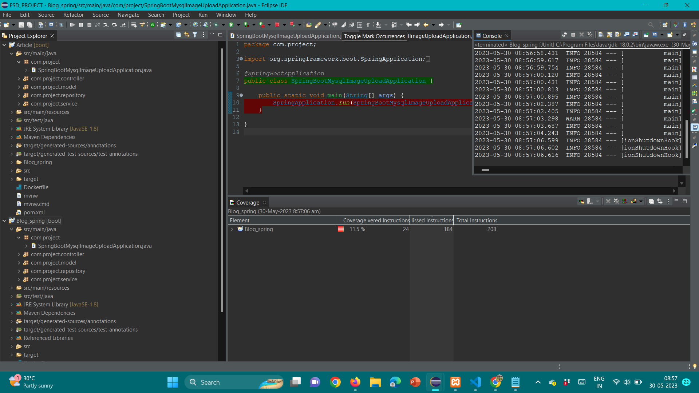
Blog

Slide 18
conclusion
Successfully implemented a news display system with a wide range of content and languages, utilizing API fetching and blog/article posting for social awareness. Future enhancements include comment sections, like buttons, share options, and a reporting feature. Docker, Hibernate, and microservices communication have been implemented to ensure scalability, efficient database interactions, and modular development.

